Slide 1
Visual Listening
Extracting Brand Image Portrayed on Social Media
21 April 2020 - Zurich
Neeraj Kumar | Linda Samsinger | Theebana Rajendram | Vincent Rüegge
Notes:
Welcome to our presentation of the project about Visual Listening or Extracting Brand Image Portrayed on Social Media.
Our team members consists of Neeraj, Linda, Theebana and Vincent.

Slide 2
Agenda
AI4Marketing
Introduction
Benefits of a Brand Management Web Tool for Marketing Personnel
Design of the Deep Learning Model Architecture
From Image Data to Model Deployment on a Web Application
Problems and Improvements
How to use Deep Learning for Marketing? | Visual Listening

Slide 3



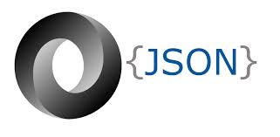

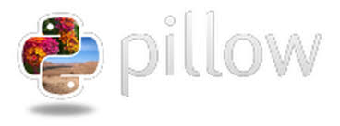








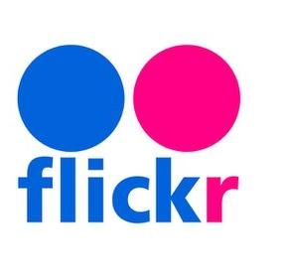

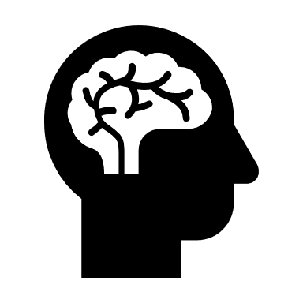
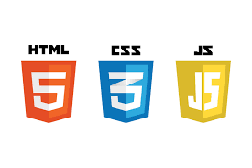
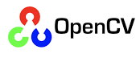
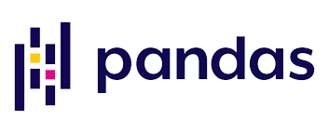
Introduction
AI4Marketing
Task: Design an AI-powered Web App to analyze brand images as portrayed on social media: Flickr (training image-to-label), Instagram (testing label-to-image)
Approach: Develop a deep learning model to classify web 2.0-sourced images based on predefined brand personality attributes and deploy the model on a Web App.
Web App: classification of official + unofficial Instagram brand profile images into 4-12 given brand personality attributes for statistical brand image profile analysis
Request
Web Application
Response
Model Prediction
Deep Learning Model
Social Media Brand URL
Brand name: official + unofficial
Classification of one brand at a time into brand attributes
How to use Deep Learning for Marketing? | Visual Listening
Notes:
Social Media: Flickr (training), Instagram (testing)
Machine Learning: build classifiers for each attribute using supervised learning & a pre-trained self-designed deep learning Convolutional Neural Network framework
Model: pre-trained self-designed deep learning Convolutional Neural Network
Web Application: classification of official + unofficial Instagram brand profile images into given brand personality attributes, brand image profile analysis

Slide 4
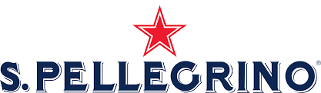
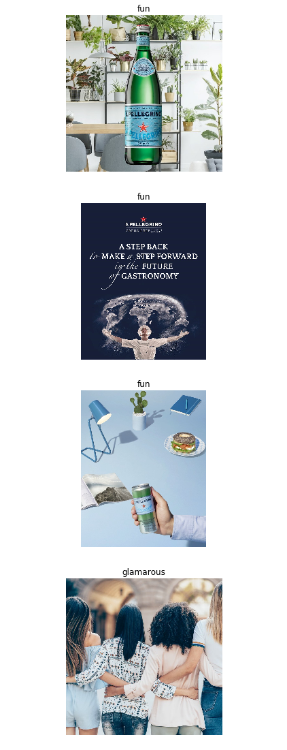
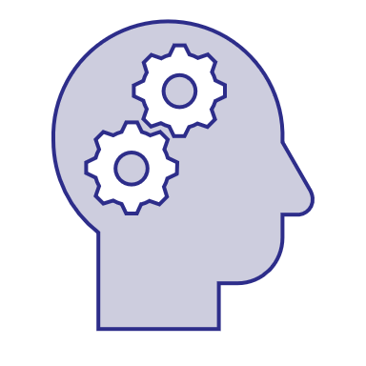

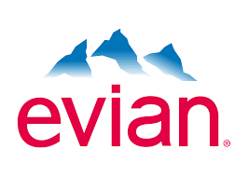

Benefits of a Brand Management Web Tool for Marketing Personnel
AI4Marketing
Consumer Insights - Better understand consumer brand perception
Benchmarking - Brand positioning and comparison with competitors
New Opportunities - Improve corporate brand image
San Pellegrino
Official portrayal is healthy 38% & fun 42%.
Unofficial portrayal is fun only 52%.
sanpellegrino_official:
#sanpellegrino:
San Pellegrino vs. Evian
San Pellegrino
«Marketing department to revise its 5-year brand positioning plan to focus on strenghtening its brand’s health benefits in advertising and social media campaigns.»
How to use Deep Learning for Marketing? | Visual Listening

Slide 5
Design of the Deep Learning Model Architecture
AI4Marketing
OneVsRest Multiclass Image Classification Problem
Classified manually annotated 16.000 images downloaded from Flickr using Linux-on-Windows into one of the following 4 attributes (+ their antonyms + UNK classes) taking the argmax probability :
Transfer Learning Approach
Used pre-trained «ResNet50» model (CNN) with 500k parameters and added our own last fully connected classifier layer.
Model Prediction
Predicted class label for brand images.
Example: Brand «DAR-VIDA»
Fun | Healthy
Glamorous | Rugged
Input: Brand Image
Output: Class Label
How to use Deep Learning for Marketing? | Visual Listening

Slide 6
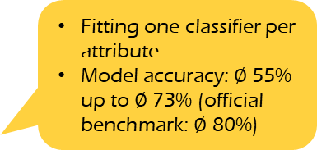
From Image Data to Model Deployment on a Web App
AI4Marketing
Resize images to same dimensions (300,300)
Remove corrupt images
Label antonym negatives for attributes
Data augmentation
Labeled
Flickr
Images
Data Preprocessing
Train-Test-Validation Split: 80:10:10
One-vs-Rest approach: multiclass classification used where each classifier was trained independently for the corresponding attribute in the dataset
Train
Validate
Test
Unlabeled
Instagram
Images
Label Classifier Model
Fitting one classifier per attribute
Model accuracy: $∅$ 55% up to $∅$ 73% (official benchmark: $∅$ 80%)
Model Prediction
Web Application
How to use Deep Learning for Marketing? | Visual Listening
Notes:
one vs rest approach of multiclass classification, we need to create 4 classifiers one for each attribute.

Slide 7
Limitations and Improvements
AI4Marketing
Back-end development: tested model on images sourced with Github Instagram API, application still pending for Pinterest API on Pinterest Developers
Downloaded 23.2 GB worth of Flickr images, 1000 for all 12 attributes (+8) using Java/ shell script, made infinite scroll possible for sourcing Instagram images, copyright/licenses/royalties, bypass video URLs, age-limited http request blockages
Enlarged pipeline throughput: ameliorated model accuracy (or F1-score) to 91.13% for attribute «healthy», but necessitates complexity vs. slimmed-down model design for user-friendliness and fast computing results
Trained Model reiterations: changed approach from one model to OneVsRest models, used different pretrained models resnet50, resnet100, and vgg16 and weights and sized them up through cross-validation, batch-trained , use multilabel instead of multiclass
Front-end development: solved naming idiosyncrasies of official Instagram brand accounts, saved images to variable not onto user’s desktop client
Tentative deployment on Google App Engine, portability across browsers, responsive design, UI/UX design, user traffic, multimedia document embedding
How to use Deep Learning for Marketing? | Visual Listening
Notes:
Twitter vs. Pinterest
12 attributes (calm, cheerful, confident, creative, exciting, fiery, happy, intelligent, natural, reliable, strong, wholesome)
This is the reason why **we can only have brands that are listed in this dataframe** and **no other brands**.
respecting user’s rights when downloading copyrighted content - not using images/videos from Instagram for commercial intent
google app engine it does not give me any errors but when you click on the link it times out and returns a '502 bad gateway' error
prefixed time horizon with tentative considersations about
multimedia document embedding –
adding images requires databank setup

Slide 8
Thank you for listening!
Neeraj Kumar | Linda Samsinger | Theebana Rajendram | Vincent Rüegge

